Slide 1
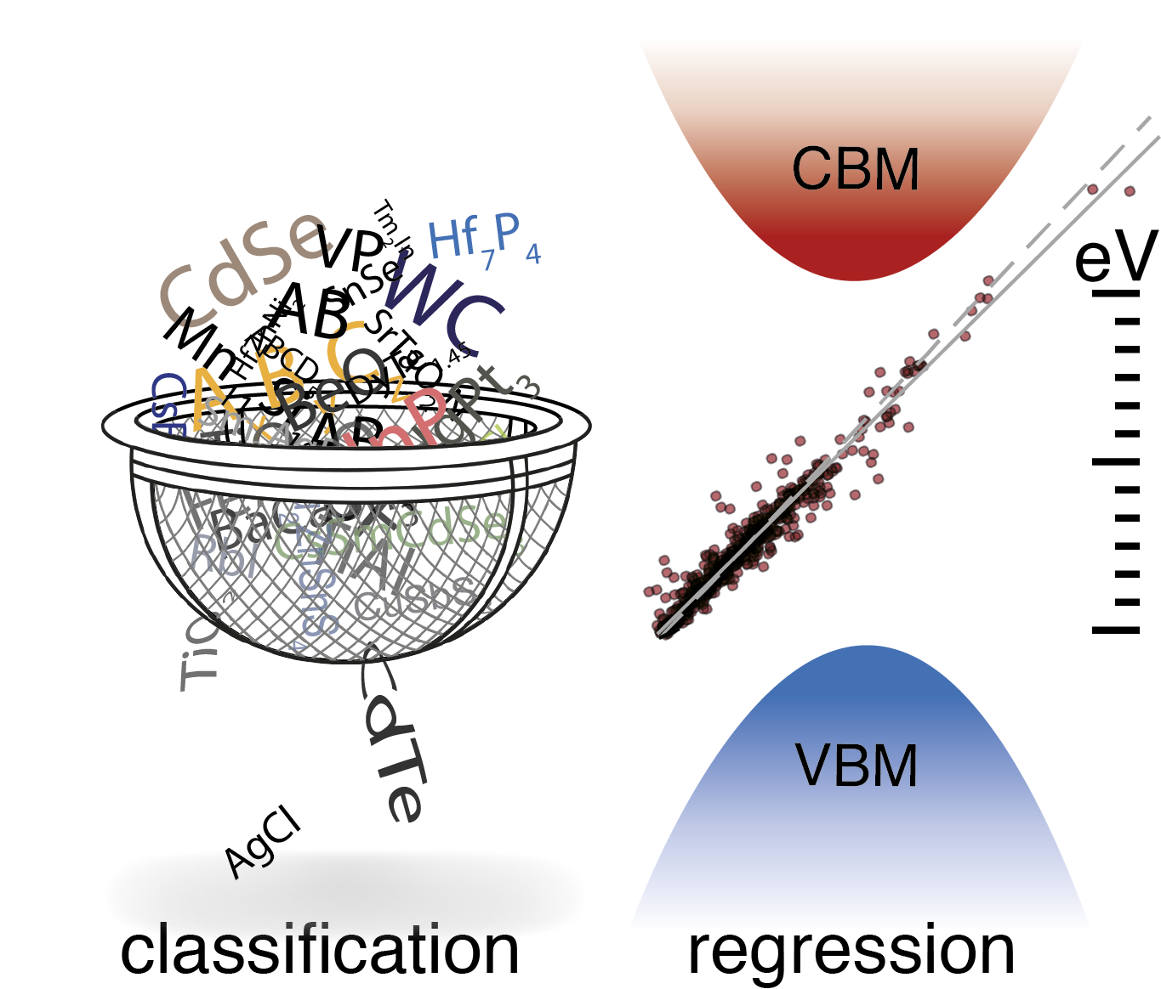
An introduction to the application of machine learning in materials science
Aria Mansouri Tehrani | University of Houston

Slide 2






Machine learning is used everywhere
Spam detection
Translation
Personalized search
Face recognition
Recommend items
Movie recommendations
Music recommendations
Self-driving cars

Slide 3
Data-driven science as the new paradigm shift in materials science
Knowledge, learned from data
Usable data is still sparse in materials science
Agrawal, Choudhary APL Materials 2016, 4.

Slide 4
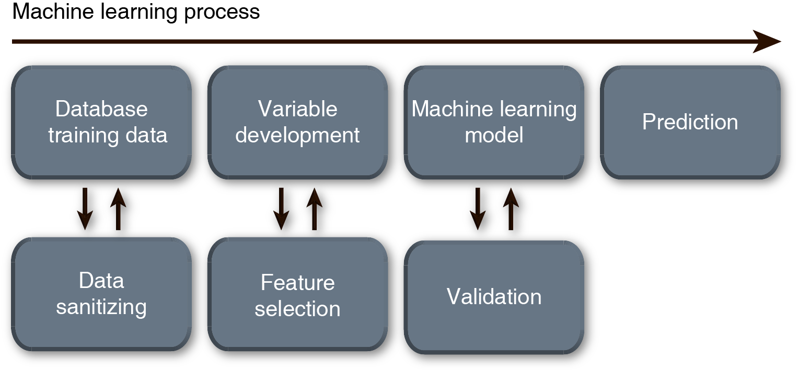
Machine learning flow

Slide 5



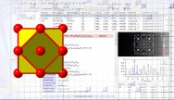


Data, data, and more data
High-throughput DFT-based databases
Databases for crystalline inorganic materials and phase diagrams
AI-powered materials data platform
https://materialsproject.org/
https://citrination.com/
http://aflow.org/

Slide 6
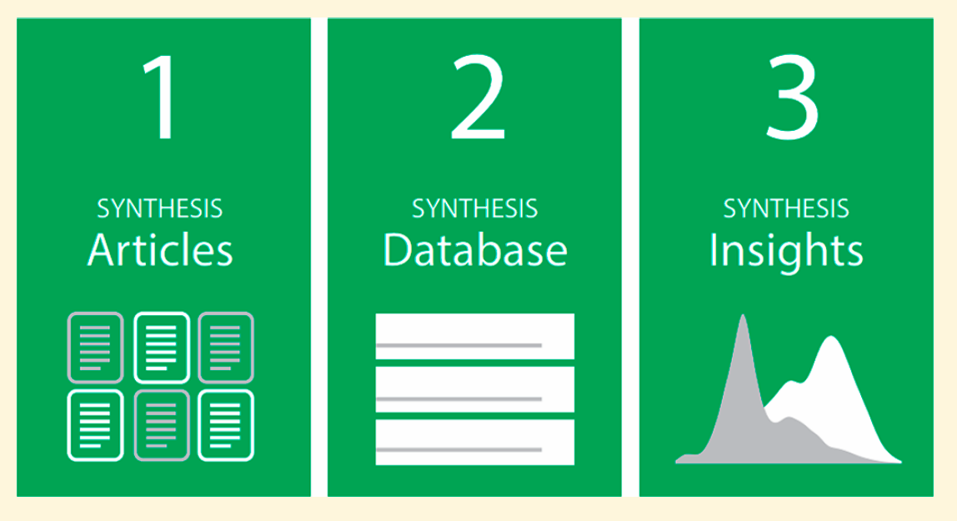
Other sources of data
1- Literature
We all use literature for our research
Extraction of data from literature is an arduous task
Designing synthesis recipe is possible from extracted data from literature
Kim et.a. Chem. Mater. 2017, 29.

Slide 7

Other sources of data
2- Lab notebooks
Extremely challenging to extract in the old fashion paper format; different person to person
The case of ‘dark’ reactions
Outperforming human strategies by predicting hydrothermal synthesis conditions with 89% success rate
Raccuglia et al. Nature 2016, 533.

Slide 8
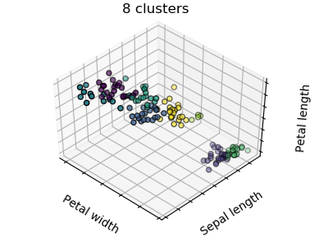
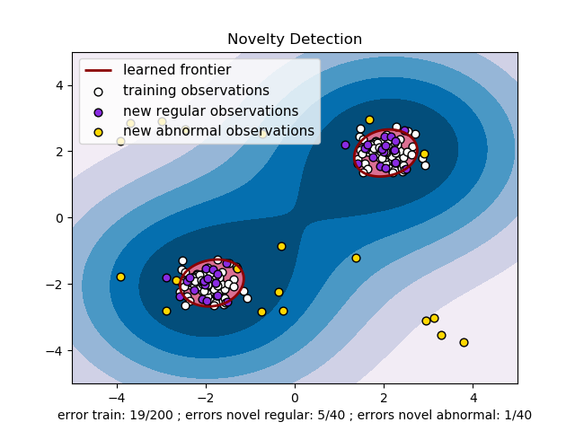
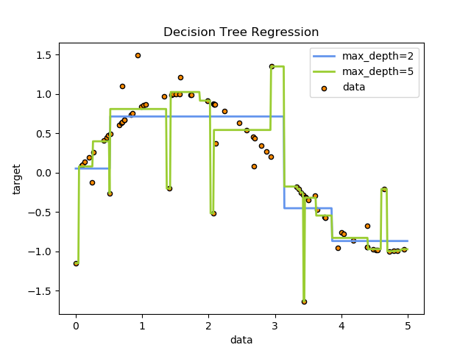
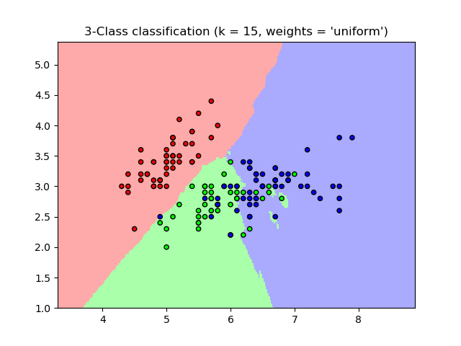
Categorizing machine-learning algorithms
Machine learning
Unsupervised learning
Supervised learning
Clustering
Dimensionality Reduction
Anomaly Detection
Regression
Classification
K-means clustering
Nearest Neighbors
PCA
One-class SVM
Decision Tree
http://scikit-learn.org/stable/user_guide.html

Slide 9
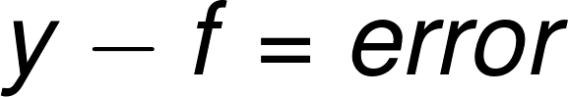
Supervised learning
The goal of learning is to identify a function using x and y values in training set to accurately predict y values for a set of unseen examples
x is the features
y is the corresponding labels
“Hypothesis space” contains all functions that can be retuned by learning
However, the choice of these functions is not unique; usually constraints are applied
Mueller, Kusne, Ramprasad. Rev. Comp. Chem. 2016, 29.

Slide 10
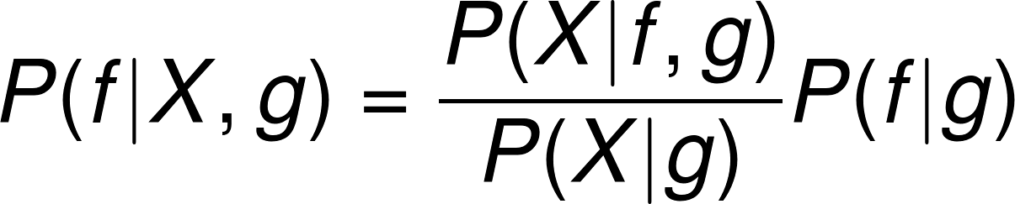
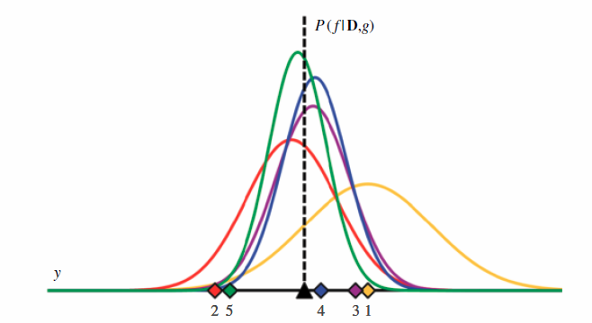
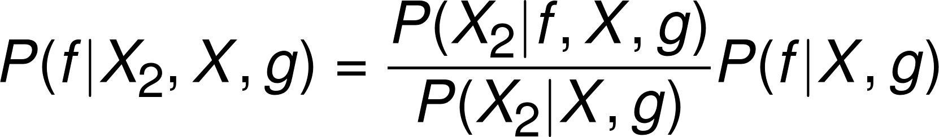
A supervised learning framework based on Bayes’ rule
Training data
Probability distribution
The next learning step after observing training data X₂:
Mueller, Kusne, Ramprasad. Rev. Comp. Chem. 2016, 29.

Slide 11
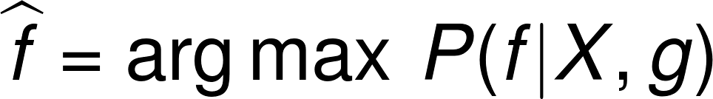
A supervised learning framework based on Bayes’ rule
Instead of dealing with many probability distributions one could maximize the posterior probability density:
Using Bayes’ rule:
Objective function
Empirical risk
Regularization term
How well f reproduces the training data
Prior constraints and weights on hypothesis space
Mueller, Kusne, Ramprasad. Rev. Comp. Chem. 2016, 29.

Slide 12
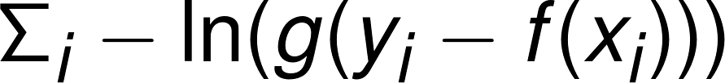
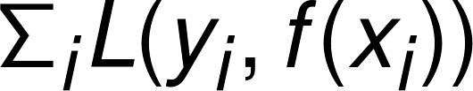
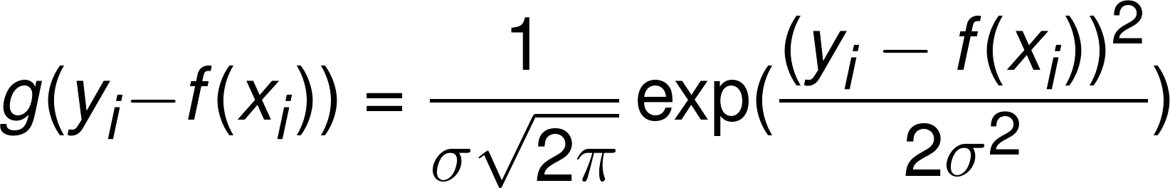
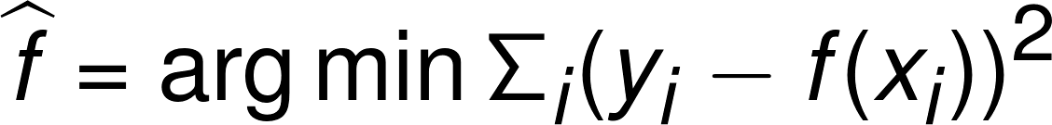
Least square treatment of the empirical risk
Objective function
Also referred to as loss function
If Gaussian with no constraint:
Least square fit defined by the least square loss function
Mueller, Kusne, Ramprasad. Rev. Comp. Chem. 2016, 29.

Slide 13



Case Studies: formation energy and crystal structure prediction
Case study 1: Creating a machine learning model for prediction of formation energies of crystalline materials
Case study 2: Crystal structure classification (cubic/hexagonal) using machine learning
All the codes associated with this presentation are written using python within the Jupyter notebook environment using Scikit-learn machine learning library
All of this data is made available for you

Slide 14
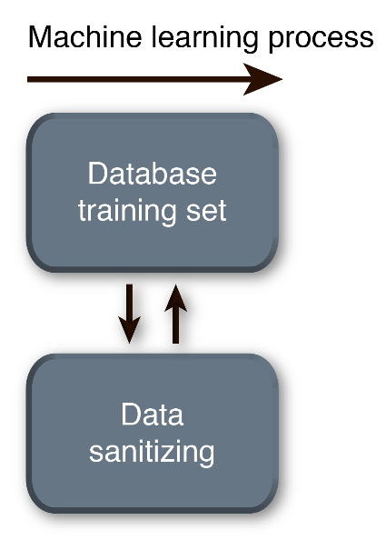
Extracting the data for case studies
The training data is extracted from materials project database (DFT)
Only A₁B₁ binaries are extracted
DFT formation energies for case study 1
Only cubic and hexagonal structures are selected for case study 2
Compounds containing Halogens, elements with Z>83 are removed such as Pu
Training set consists of 694 binaries including 521 cubic and 173 hexagonal structures

Slide 15
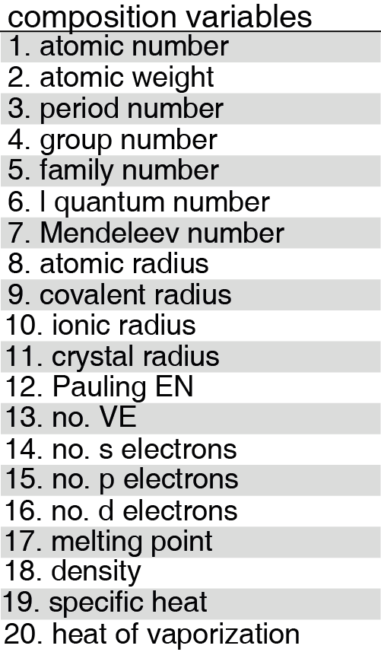
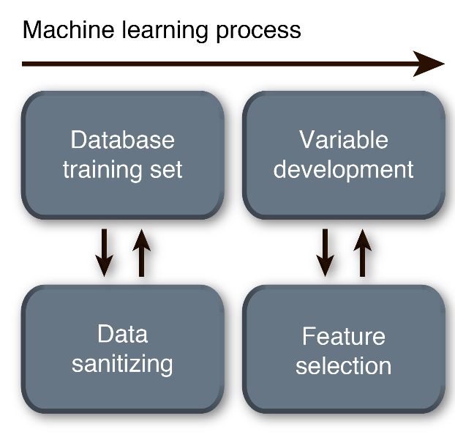
Building the feature set for case studies
20 compositional variables are used in both case studies
4 mathematical expression are added for each variable
Element A, element B, Average, Difference
For example for BN the atomic number variables are:
5, 7, 2, and 6
So each compound is represented by 80 variables in a form of an array
Since there are 694 compounds, a 694×80 matrix is created; we are in a 80 dimension space

Slide 16
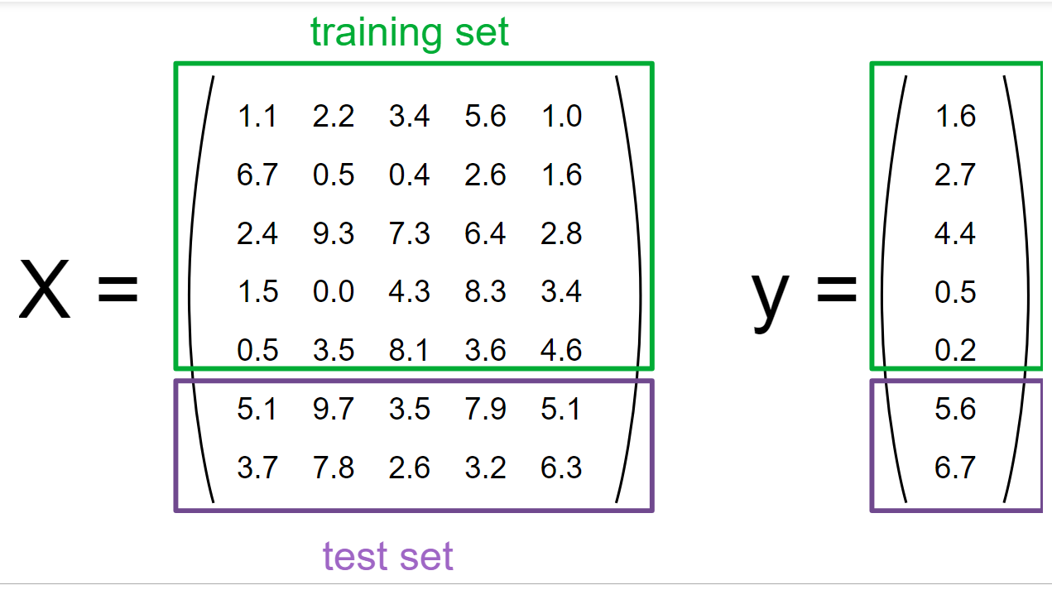
Splitting the data set into training and test set for case studies
Splitting is to fairly evaluate the predictive power of the model
Here, this division is done with a ratio of 80% to 20%
The data is further normalized
http://scikit-learn.org/stable/user_guide.html

Slide 17
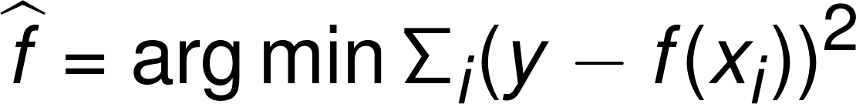
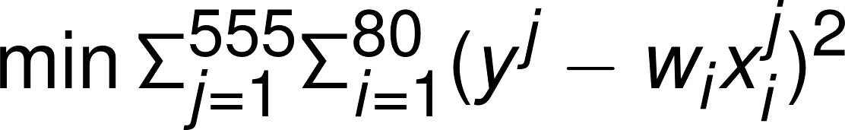
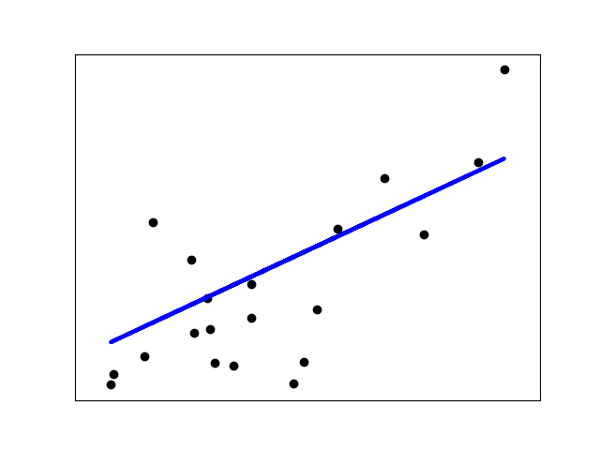
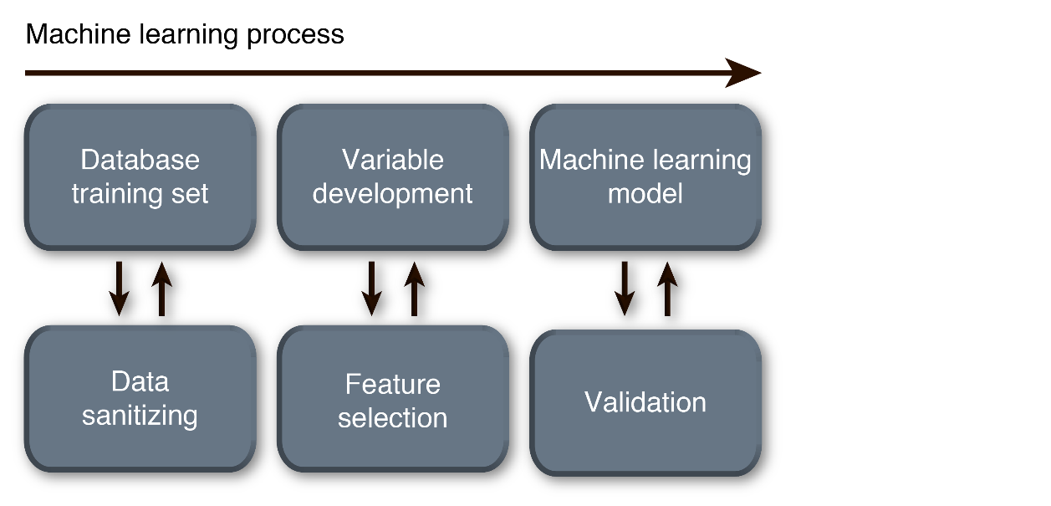
Case study 1: Implementation of ordinary least squares
Linear models are generally defined as:
Training data
Coef.
intercept
Ordinary least squares:
http://scikit-learn.org/stable/modules/linear_model.html

Slide 18
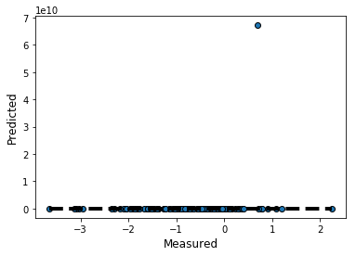
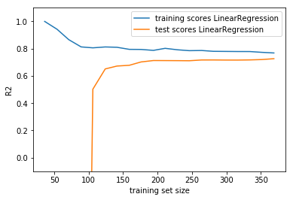
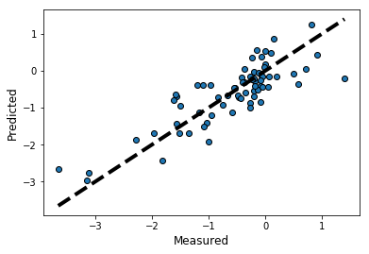
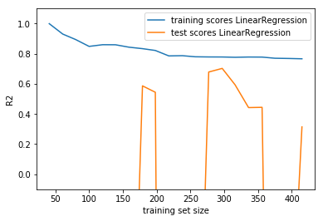
Case study 1: Evaluation of the ordinary least square model
Prediction of formation energies on test set
Learning curve of formation energies
Linear regression is not stable with various splitting of test and train data and is ill-defined

Slide 19
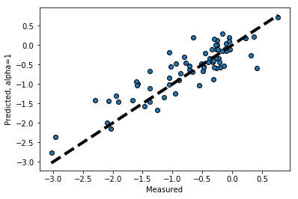
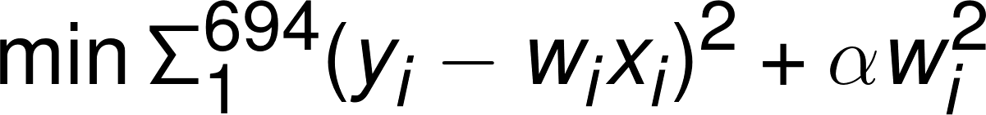
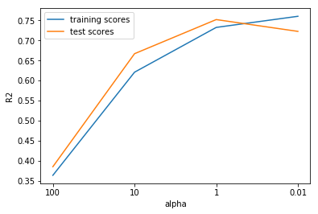
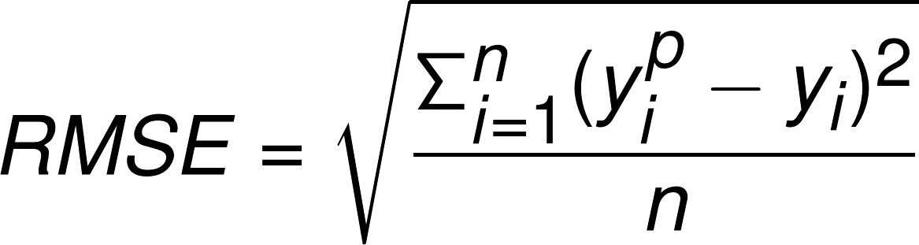
Case study 1: Addition of a regularization term
Adding a regularization term to the ordinary regression
Ridge regression of formation energies on the test set
RMSE = 0.38 eV
R² = 0.75

Slide 20
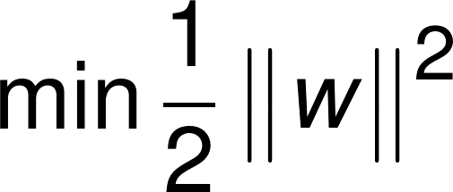
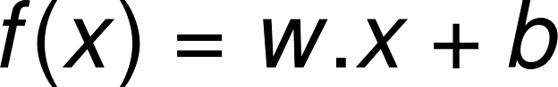
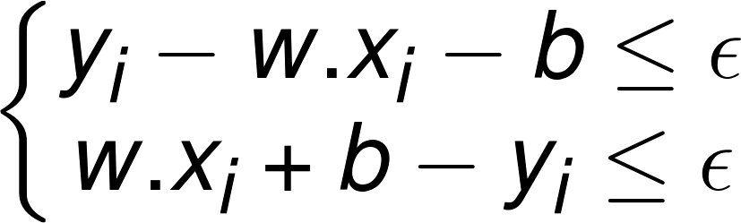
Case study 1: Support vector regression (SVR) method
Empirical risk (loss function)
Subject to
Goal is to find f(x) that has at most ϵ deviation from targets y_{i} for all the training data while being as flat as possible
Smola and Scholkopf. Statistics and Computing 2004, 14.

Slide 21
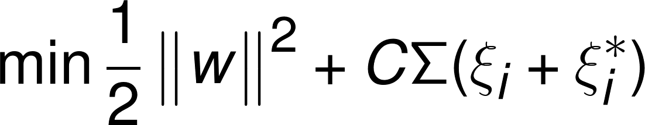
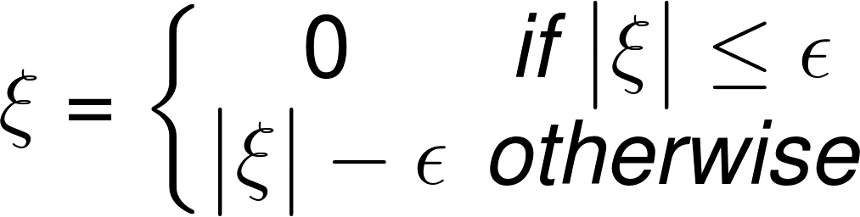
Case study 1: Introducing regularization in SVR
The constant C determines the trade-off between the flatness of f and the amount which deviations larger than ϵ are tolerated
If the data is not solvable a kernel function could map the data into higher dimension where optimization is feasible
Smola and Scholkopf. Statistics and Computing 2004, 14.

Slide 22
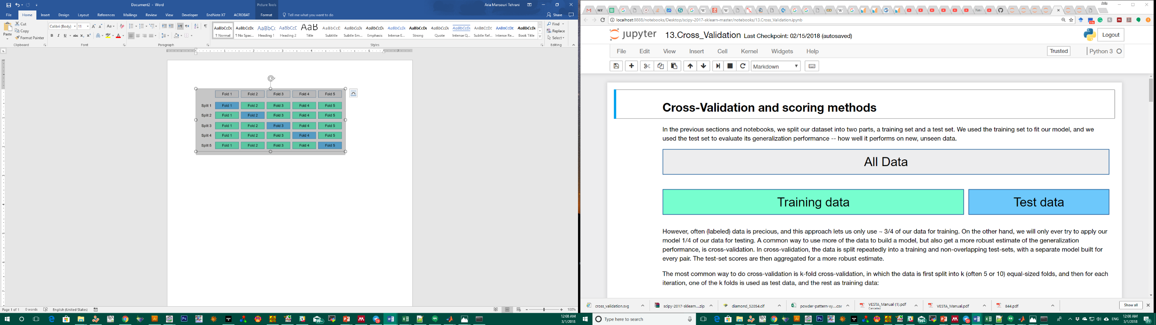
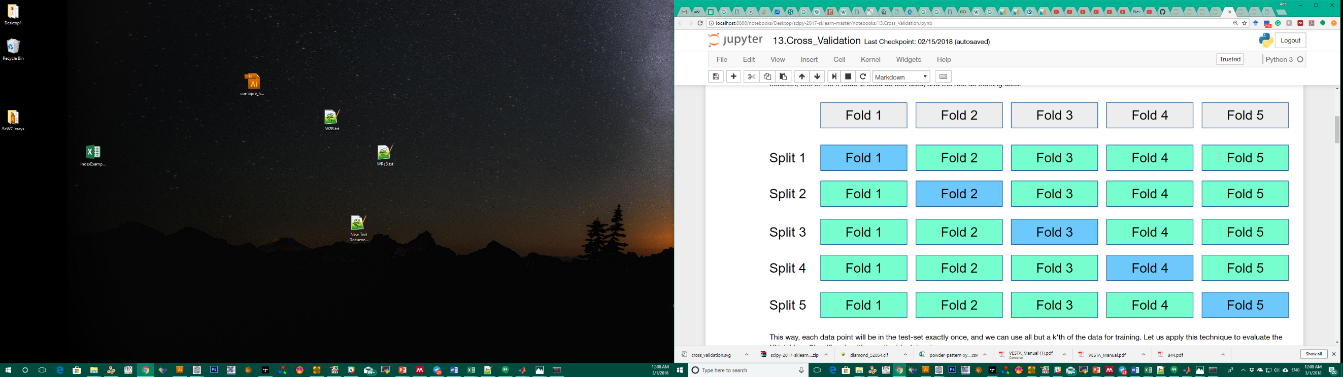
Case study 1: Tuning SVR parameters using cross-validation
5-fold cross-validation
1- Helps saving data for training!
2- Avoiding over-fitting
3- Tuning regularization parameter
4- Fair evaluation of the performance
https://www.youtube.com/watch?v=2kT6QOVSgSg

Slide 23
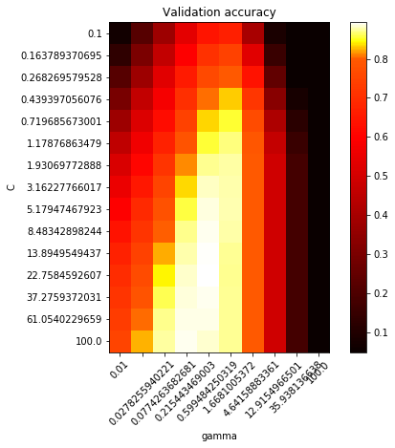
Case study 1: Tuning SVR parameters using cross-validation
Best performance is achieved using:
C= 10 γ = 1
C is the regularization term
γ is a variable in the RBF kernel function used in this model

Slide 24
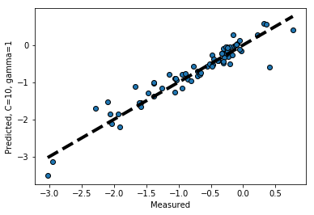
Case study 1: Machine learning formation energies using SVR
Support vector regression
Ridge regression
RMSE = 0.32 eV
RMSE = 0.38 eV
R² = 0.87
R² = 0.75

Slide 25
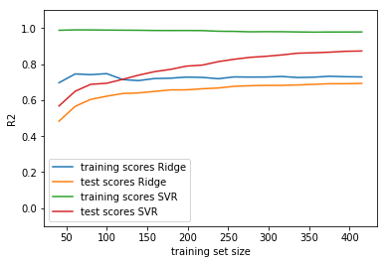
Case study 1: Comparing learning curves in formation energy ML
Statistics should be evaluated on test set, not training set!
Reasonable models are achievable with modest number of training data and simple regression practices

Slide 26
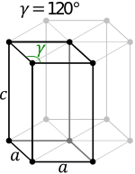

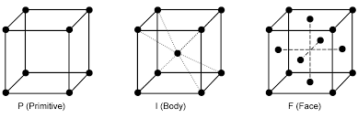
Case study 2: Classification of crystal structures
Only A₁B₁ binaries are extracted
Only Cubic and Hexagonal structures are selected denoted as class 0 and class 1
Training set consists of 694 binaries including 521 cubic and 173 hexagonal structures
Can we learn and predict crystal structures based on compositional descriptors?

Slide 27
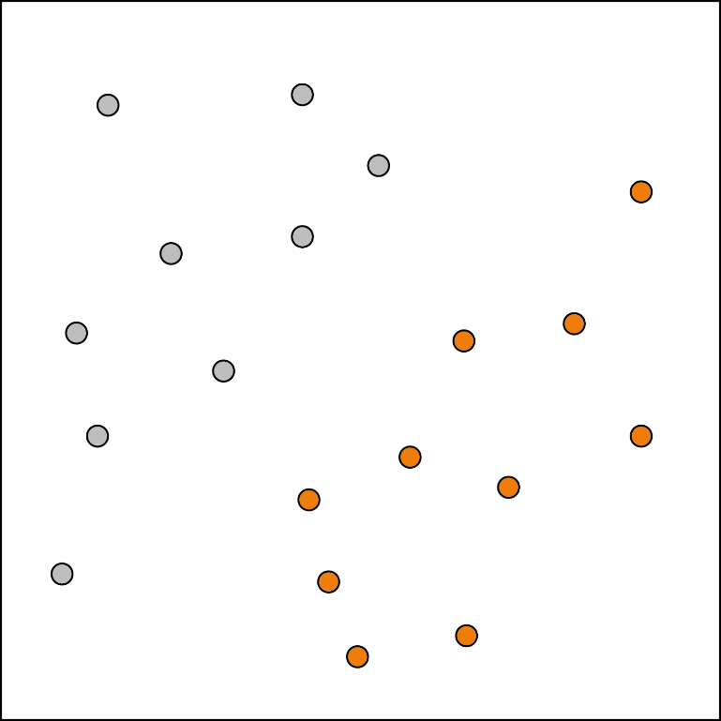
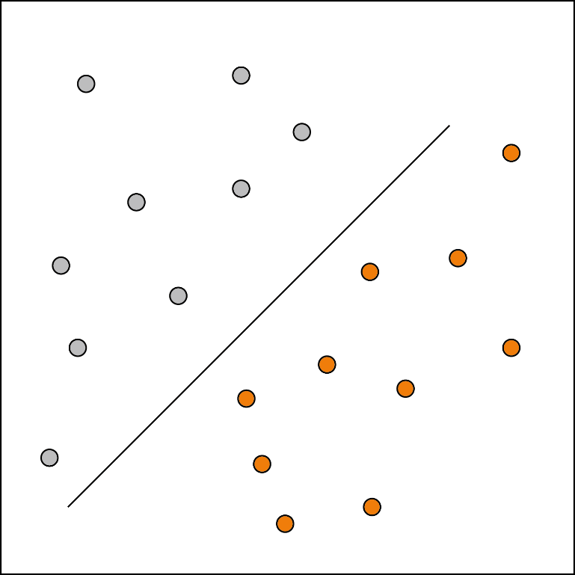
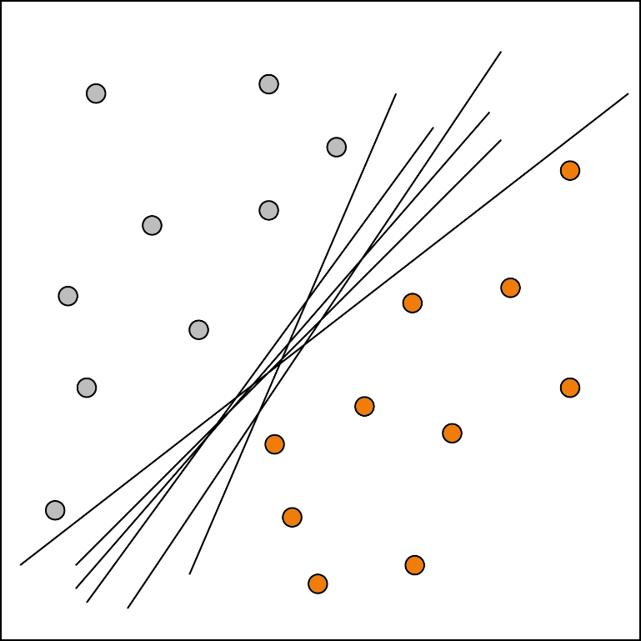
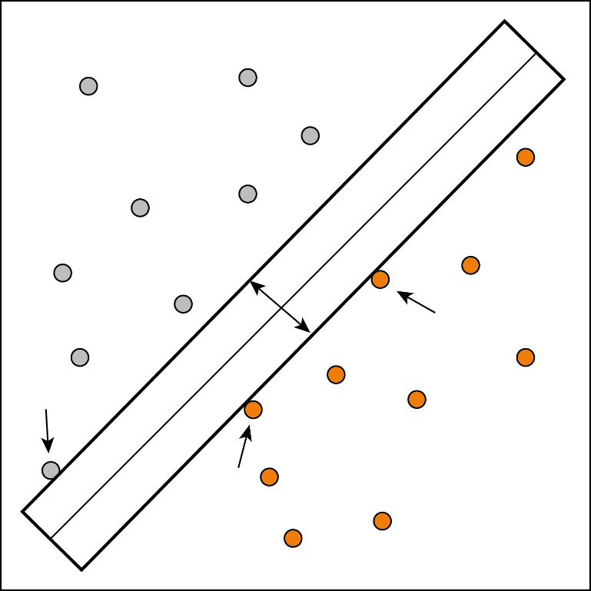
Case study 2: Support vector classification (SVC)
The idea is similar to regression but the respond (y) are discreet instead of continuous
W
?
The goal of classifier is to define a hyperplane that best classifies all training vectors (data)
The optimal hyperplane is achieved by maximizing the margin (W) defined by the support vectors

Slide 28
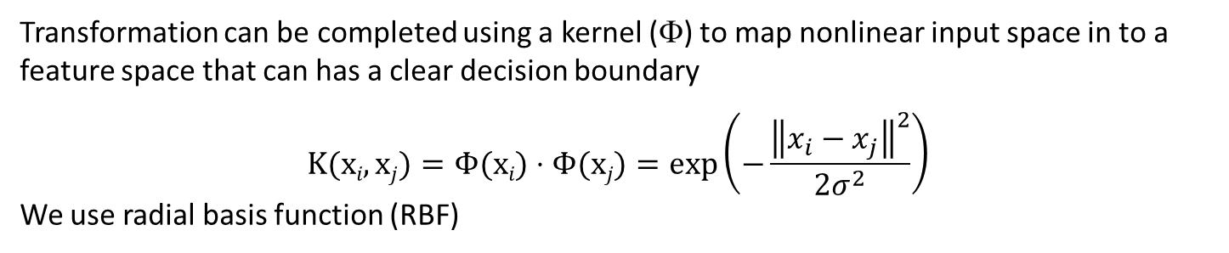
Case study 2: Projecting input space to feature space
<Φ$i$,Φ$j$>
input space
feature space
Transformation can be completed using a kernel (Φ) to map nonlinear input space in to a feature space that can has a clear decision boundary
$$K(xi,xj)=Φ(xi)⋅Φ(xj)=exp\left(−\frac{{\left\|x_{i}−x_{j}\right\|}^{2}}{2σ^{2}}\right)$$
We use radial basis function (RBF)

Slide 29

Case study 2: Tuning SVC parameters using cross-validation
Best performance is achieved using:
C= 10 γ = 1
Classification accuracy is: 0.87
Evaluated on test set

Slide 30

Case study 2: ROC curve for classification evaluation
True positive rate: ratio of correctly identified cubic structures to all cubic structures
False positive rate: ratio of incorrectly identified cubic structures to all hexagonal structures

Slide 31

Case study 2: Preprocessing matters!
Support vector machine is sensitive to normalization of the data
Scaled and normalized data
Unprocessed data
Accuracy: 0.87
Accuracy: 0.78

Slide 32

Case study 2: Unbalanced data should be dealt with care
Here, the data is deliberately made unbalanced with 520 cubic structures and only 5 hexagonal structures (≈1%)
Balanced data:
Unbalanced data:
Accuracy: 0.87
Accuracy: 0.73
Equivalent of random guess!

Slide 33
The choice of descriptors is not unique!
Materials properties have been modeled using a set of descriptors based on only atomic connections in the crystal
Xie, Grossman. arXiv. 2017.

Slide 34
The choice of descriptors is not unique!
Machine learning the DOS at fermi level using partial radial distribution function (PRDF) as descriptor
Schutt et al. Phys. Rev. B. 2014, 89.

Slide 35


Structure prediction and polymorphism of ABC phases
Oliynyk et al. JACS 2017, 139.

Slide 36


Predicting the band gaps of inorganic solids
Trained based on 2458 experimental band gap values with a accuracy surpassing PBE!
Based only on compositional data
Zhuo, Mansouri Tehrani, Brgoch. J. Phys. Chem. Lett. 2018, 139.

Slide 37

Identifying an Efficient, Zero-Thermal Quenching Inorganic Phosphor
Debye temperature is a descriptor for photoluminescent quantum yield and is machine learned
The model is further used to screen and identify efficient phosphor host
Stay tuned for Ya Zhuo’s flash talk for more details!
Zhuo, Mansouri Tehrani, Oliynyk, Duke, Brgoch. submitted. 2018.

Slide 38


Identifying hardest transition metal carbide and borocarbide
Bulk and shear modulus are modeled using SVR and a combination of compositional and structural variables
The model is used to screen for potentially superhard materials
Experimental verifications are performed
Mansouri Tehrani, Oliynyk, Parry, Rizvi, Couper, Lin, Miagi, Sparks, Brgoch. submitted. 2018.

Slide 39







Acknowledgment
Prof. Jakoah Brgoch, advisor
Dr. Anton Oliynyk, post doc
Prof. Taylor Sparks
(NSF CMMI 15-62142)
(55625-DNI10)

